Slide 1

Accounting Fraud Detection
By: Bini Teklehaimanot

Slide 2
Agenda
Problem Identification
Key Findings and Recommendations
Modeling Results and Analysis
Summary and Conclusion

Slide 3

Problem Identification
Goal: Develop a robust fraud detection framework to identify accounting misstatements using publicly available financial statement data from U.S. publicly traded companies.
Focus Factors: Evaluate structured accounting features such as retained earnings, accounts payable, and working capital changes to uncover patterns indicative of fraud.
Data Context: The dataset comprises firm-level accounting data drawn from 10-K filings of publicly traded U.S. companies. Each observation is labeled as either misstated or not, based on prior enforcement actions and audit findings — enabling supervised learning for fraud detection.
EDA Insight: Outliers were retained to preserve data integrity, acknowledging the wide variability in firm size and reporting behavior across U.S. companies. Class imbalance and non-linear relationships warranted advanced model selection beyond traditional approaches.

Slide 4

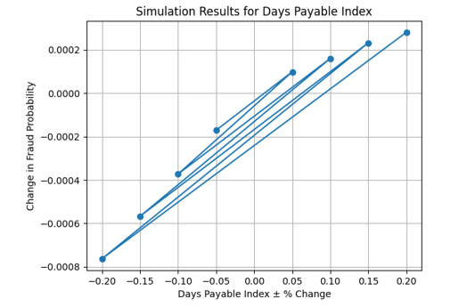
Key Findings AND Recommendations
Key Insights:
A 20% increase in Days Payable Index (DPI) led to the largest simulated spike in fraud probability, flagging DPI as a leading risk signal.
Accounts Payable and Retained Earnings movements correlated with elevated fraud risk — suggesting liquidity pressure and earnings manipulation.
Common Shares Outstanding showed an inverse relationship, hinting at more transparent equity-backed financing.
Recommendations
Integrate DPI thresholds into internal risk scoring models to surface audit targets
Prioritize monitoring of working capital shifts and sudden drops in retained earnings.
Use blended model predictions to triage firms for forensic review in quarterly filings.

Slide 5
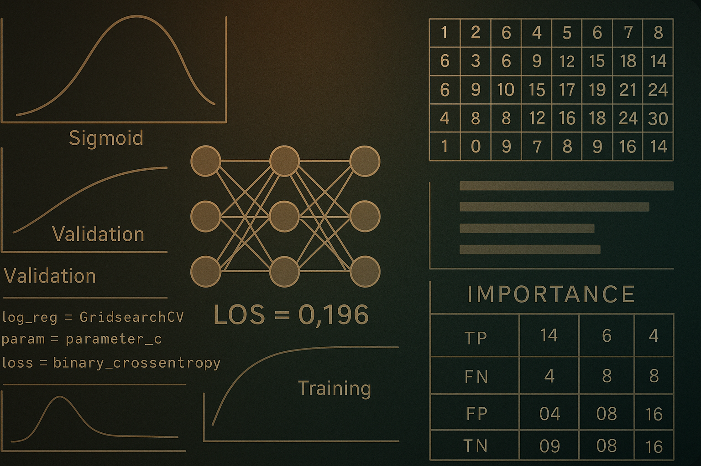
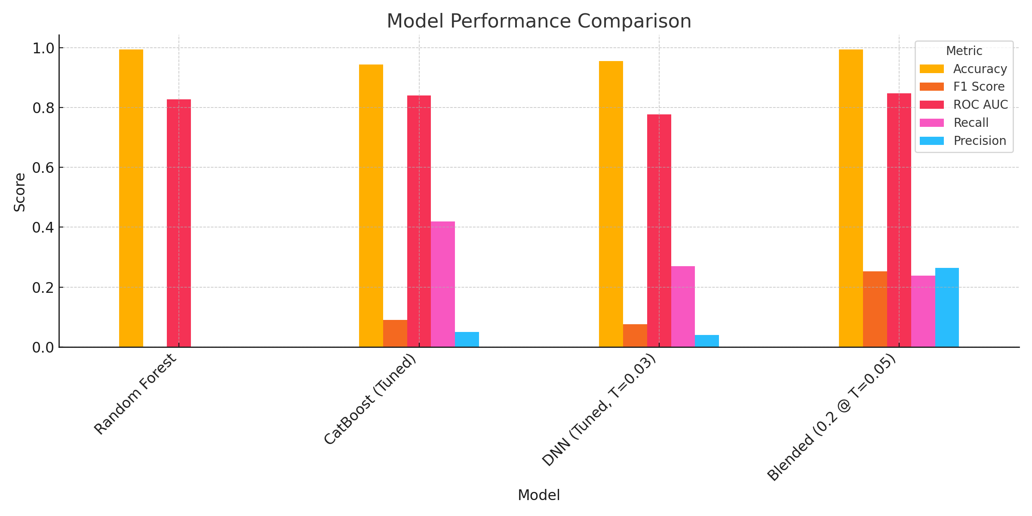
Modeling Results and Analysis
Three supervised models were evaluated: Random Forest, CatBoost, and Deep Neural Network (DNN).
Final model selection prioritized F1-score and recall to balance fraud detection performance in a highly imbalanced dataset.

Slide 6

Summary and Conclusion
Fraud detection in financial reporting is feasible using public data — Our model demonstrates that even imbalanced datasets can surface meaningful red flags with the right combination of algorithms and tuning.
Simulation and interpretability matter — Targeted feature perturbation revealed which accounting variables most influence fraud risk, offering actionable insights for auditors and analysts.
Blended modeling outperformed standalone approaches — Combining CatBoost with Deep Learning improved fraud signal detection, demonstrating the power of hybrid models in sensitive financial domains.

